Slide 1
Implementing Sustainable Practices in Airline Digital Endpoint Device Usage

Slide 2
Contents
Abstract
Objectives
Gantt Chart
Data Collection
Analysis Results
Recommendations

Slide 3
01
Abstract

Slide 4
All about
company
Employees
Reducing environmental impact of digital devices used by Royal Jordanian airline
employees through sustainable procurement, energy-efficient practices, and employee engagement.

Slide 5
02
Objectives

Slide 6
Literature review
Reduce the environmental impact of digital endpoint devices used by Royal Jordanian airline employees, including laptops, tablets, and smartphones.
Implement sustainable procurement policies for digital endpoint devices.
Engage employees in sustainable behaviors related to the use of digital devices.
Involve representatives from IT, procurement, sustainability, and employee training departments in the project.
Collaborate with stakeholders such as Royal Jordanian airline customers, shareholders, regulatory bodies, and sustainability advocacy groups.
Develop a sustainable procurement policy for digital endpoint devices.
Conduct awareness campaigns and provide resources to encourage sustainable practices.

Slide 7
03
Gantt Chart

Slide 8
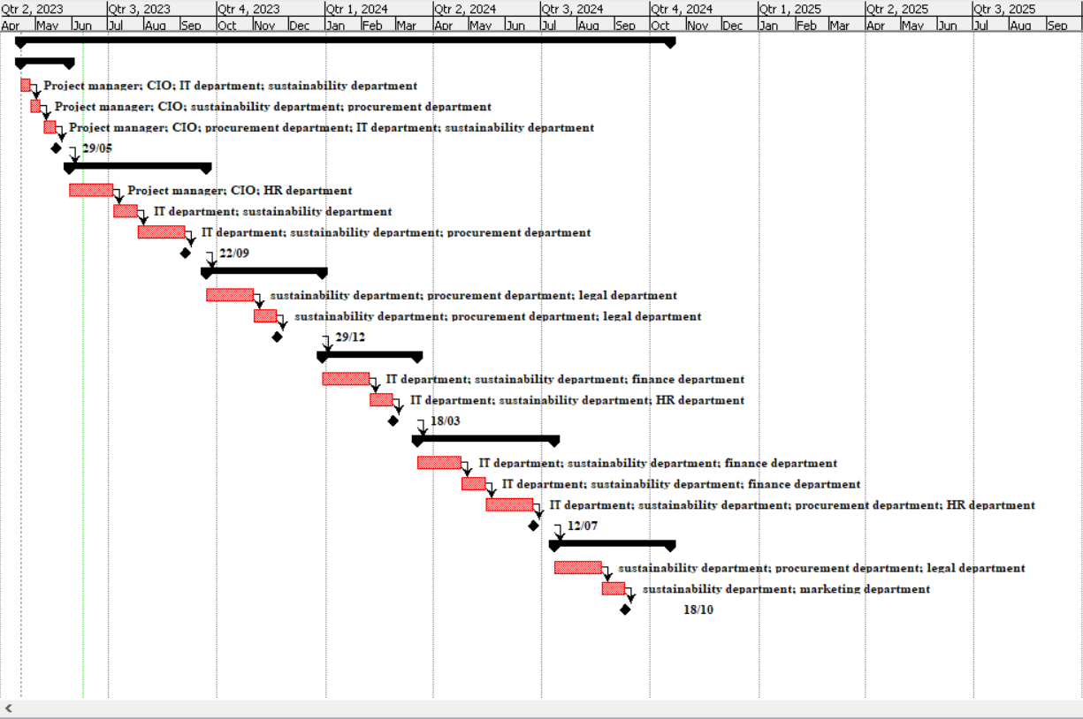

Slide 9
Scope
The Sustainable Practices for Digital Endpoint Devices project aims to reduce the environmental impact of digital devices used by Royal Jordanian airline employees. It focuses on laptops, tablets, and smartphones. The project includes implementing sustainable procurement policies, promoting energy-efficient practices, and engaging employees in sustainable behaviors. It covers all digital devices used
by employees and involves representatives from IT, procurement, sustainability, and employee training departments. Stakeholders such as customers, shareholders, regulatory bodies, and sustainability advocacy groups are also involved. The project's deliverables include a sustainable procurement policy, a supplier evaluation process, employee training programs, awareness campaigns, a monitoring system for sustainability metrics, and sustainability reports to communicate progress.

Slide 10
Resources
Project Initiation and Planning:
Sustainable Procurement Policy Development:
Employee Engagement and Training:
Project manager
CIO (Chief Information Officer)
IT department
Sustainability department
Procurement department
HR department
Procurement department
Sustainability department
Legal department
HR department
Sustainability department
IT department
Marketing department

Slide 11
Resources
Monitoring and Evaluation:
Reporting and Communication:
Sustainability department
IT department
Finance department
Procurement department
HR department
Sustainability department
Marketing department
Finance department
CIO (Chief Information Officer)
HR department

Slide 12
581,179
Cost

Slide 13
04
Data Collection

Slide 14

Data Collection Process and Sampling
I used a Non-Probability Sampling Technique and it was used on the it department plus some people from the airport who work in RJ and i used a mixed survey Technique

Slide 15
05
Analysis Results

Slide 16
Results
Passengers travel with 2 to 3 digital devices on average when flying with Royal Jordanian airline.
Participants own around 3 devices in their daily lives.
They retain and utilize 2 to 3 used devices alongside newer ones.
Increased energy consumption is acknowledged without specific estimates.
Environmentally sustainable digital devices should be priced comparably to traditional ones.
Major environmental impacts of digital transformation include increased energy consumption, waste production, and non-renewable resource use.
Challenges in reducing environmental impact include cost, balancing efficiency and sustainability, and research and planning.
Effective communication methods suggested include advertisements, announcements, and social media.
Balancing factors involves using older devices, considering environmental impact, and making conscious choices in personal lives.

Slide 17
06
Recommendations

Slide 18
Recommendations
Encourage passengers to minimize the number of devices they travel with.
Promote sustainable practices for device usage during flights.
Assess and optimize the airline's digital systems for energy efficiency and waste reduction.
Set clear sustainability goals and metrics for tracking performance.
Collaborate with suppliers for affordable and accessible sustainable devices.
Communicate the airline's commitment to environmental sustainability.
Educate employees and passengers on the trade-off between convenience and sustainability.
Continuously monitor and improve sustainability initiatives.
Foster a culture of sustainability and employee involvement.

Slide 19
Thanks!
Do you have any questions?
soberkareem@gmail.com
00962789266566

